Slide 1
VTC6A #6 data analysis

Slide 2
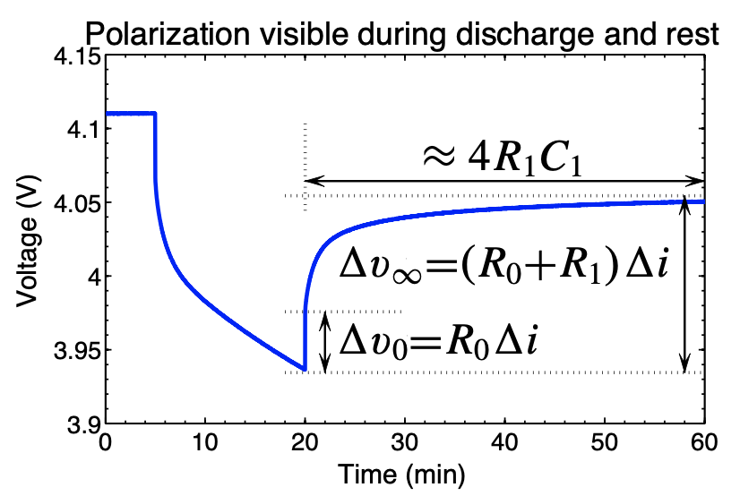
Primary Theoretical Foundation
ECE4710/5710, Equivalent-Circuit Cell Models, Note 2 Page 10

Slide 3
part 1
@4.0V, 3.8V, 3.6V, 3.4V

Slide 4
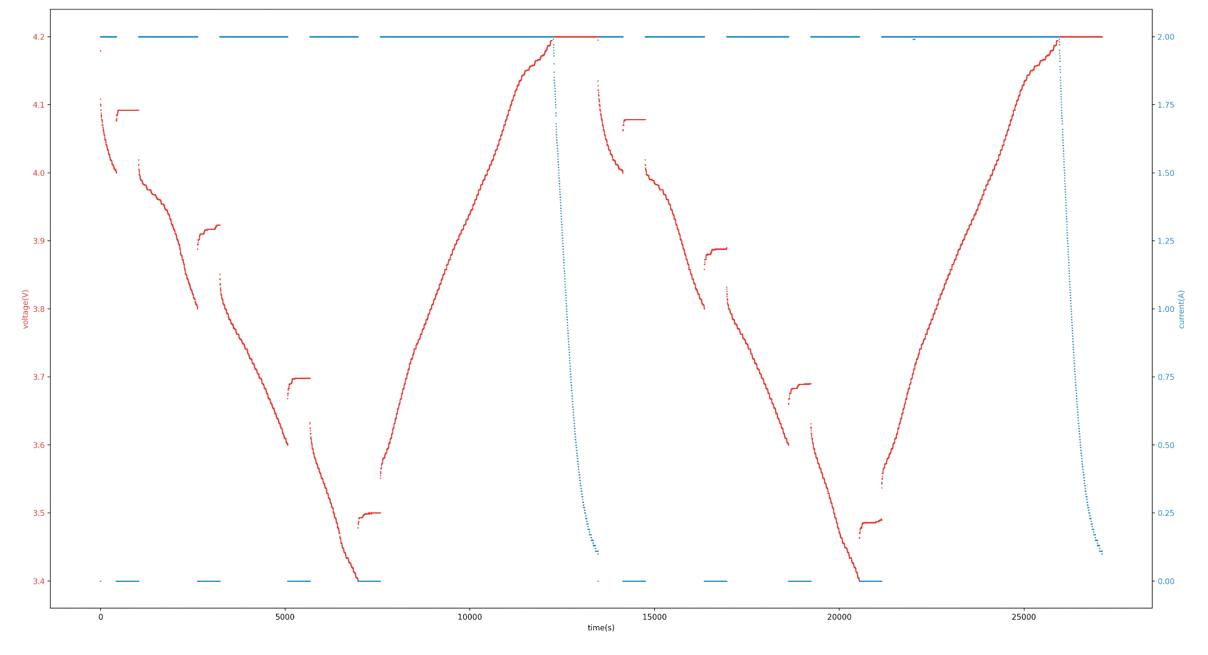
10-13/equiv-circuit-1st-part-2021-10-14-8-33-31-EBC-A20-1-1.csv
split into 8 sections of “discharge-and-rest” (from left to right)

Slide 5
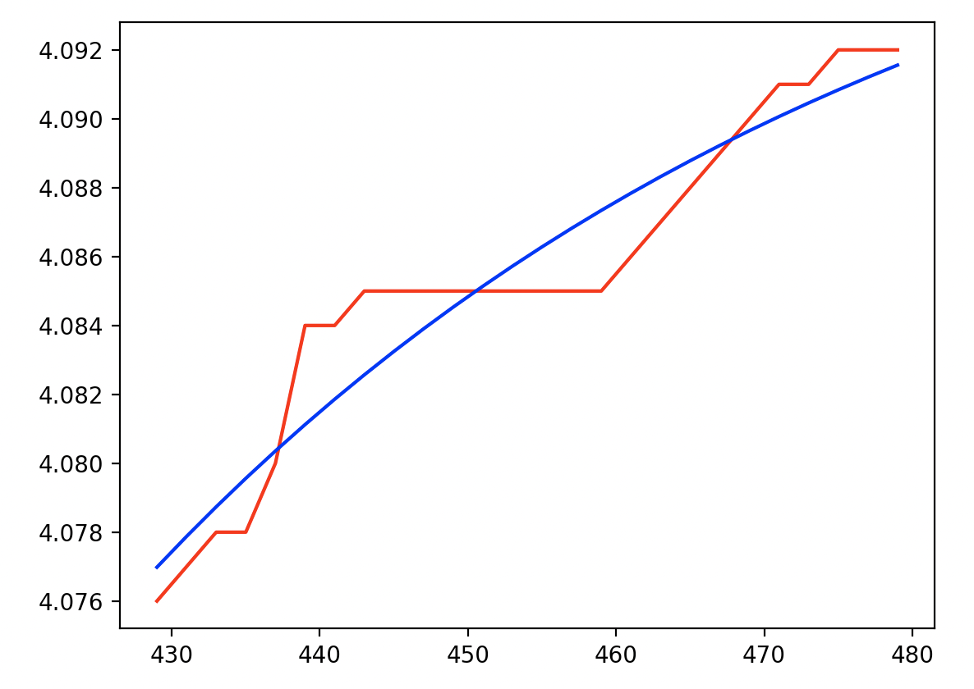
section 1
popt = [-0.02346676 4.10044973 0.01940917]
R0 = 0.0380
R1 = 0.0080
R1 * C1 = 51.5220
C1 = 6440.2555
voltage_est_MSE = 1.8597051160125211e-06

Slide 6
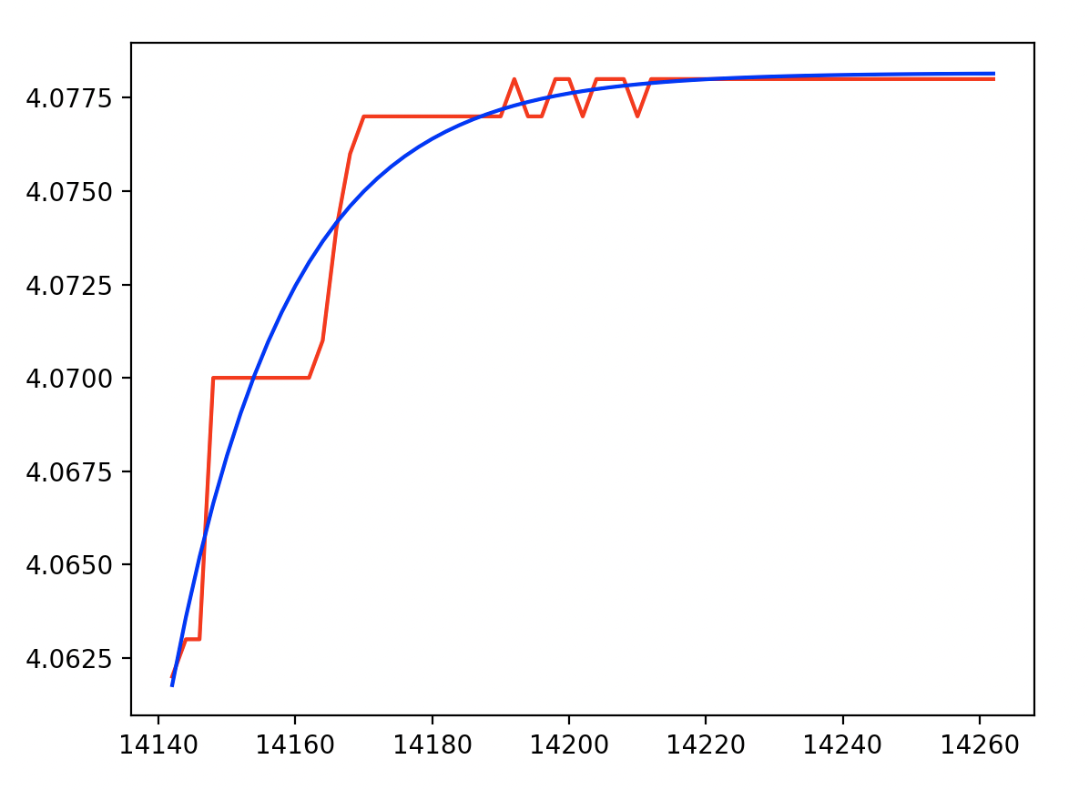
section 5
popt = [-0.01639051 4.07816198 0.05868828]
R0 = 0.0310
R1 = 0.0080
R1 * C1 = 17.0392
C1 = 2129.8973
voltage_est_MSE = 1.0548331509760441e-06

Slide 7
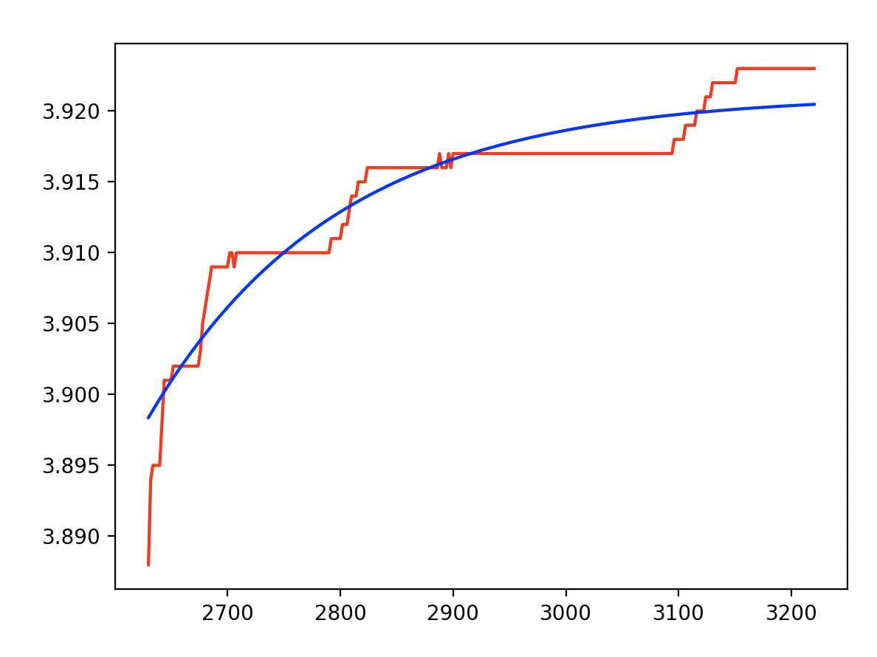
section 2
popt = [-0.02277571 3.92114332 0.00596822]
R0 = 0.0440
R1 = 0.0175
R1 * C1 = 167.5542
C1 = 9574.5262
voltage_est_MSE = 3.879849367161791e-06

Slide 8
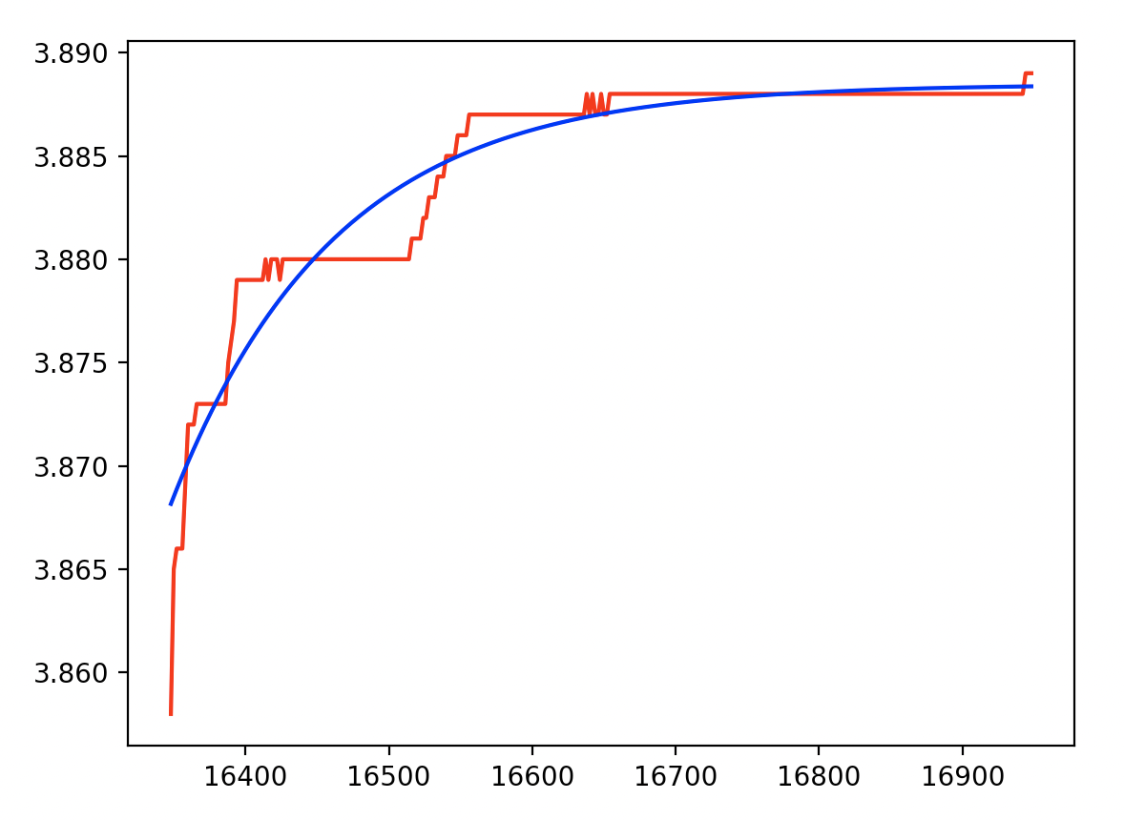
section 6
popt = [-0.02030598 3.88846919 0.00879906]
R0 = 0.0290
R1 = 0.0155
R1 * C1 = 113.6485
C1 = 7332.1604
voltage_est_MSE = 2.0507394206959095e-06

Slide 9
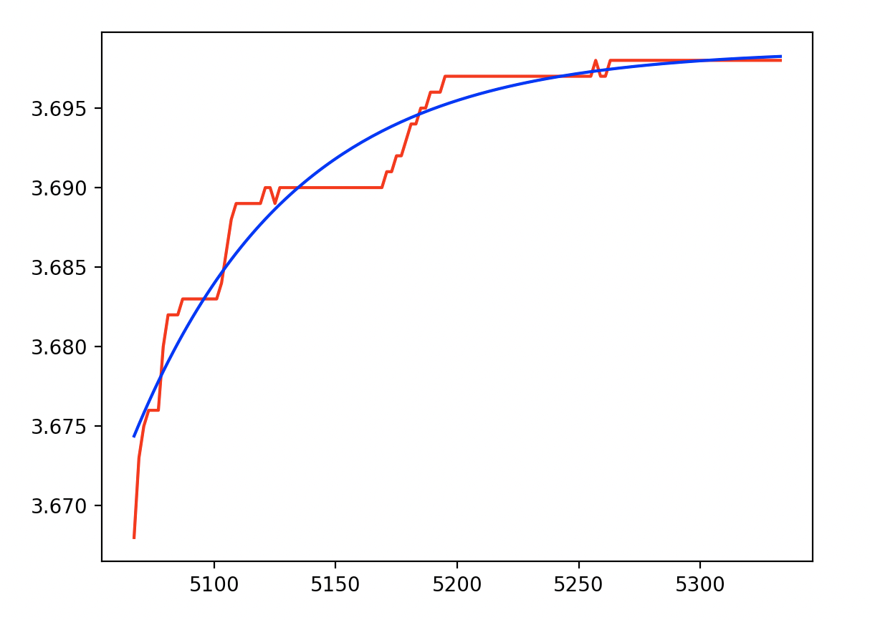
section 3
popt = [-0.02428671 3.69866708 0.01526106]
R0 = 0.0340
R1 = 0.0150
R1 * C1 = 65.5262
C1 = 4368.4165
voltage_est_MSE = 2.0411824755016863e-06

Slide 10
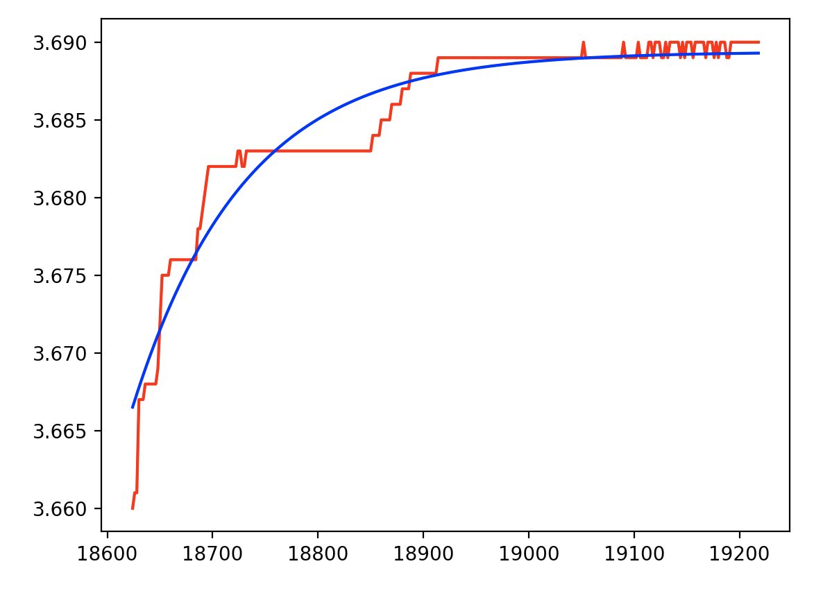
section 7
popt = [-0.02286897 3.68937866 0.00945205]
R0 = 0.0300
R1 = 0.0150
R1 * C1 = 105.7972
C1 = 7053.1468
voltage_est_MSE = 2.55411300399706e-06

Slide 11
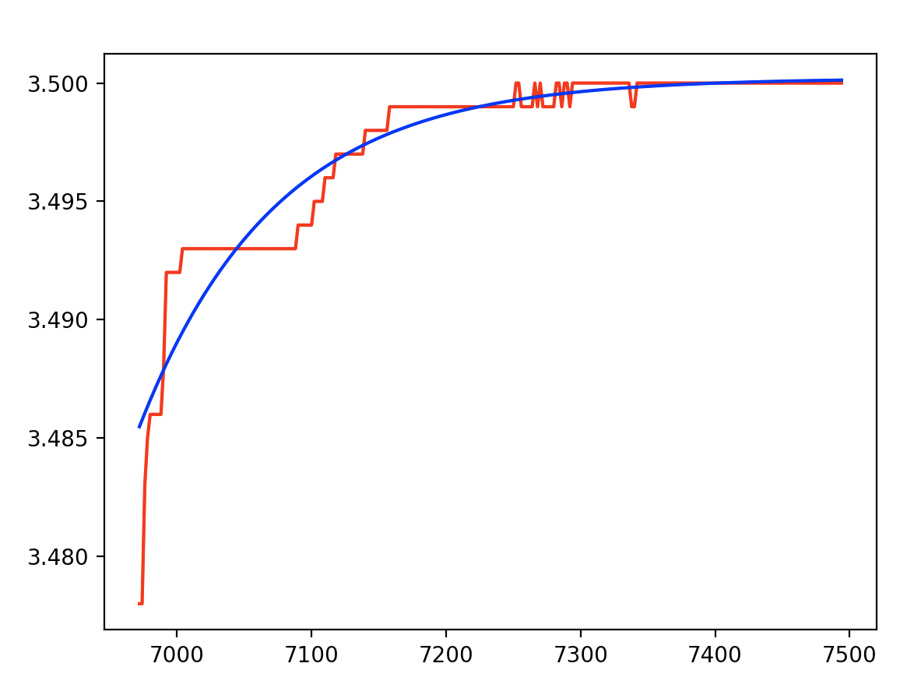
section 4
popt = [-0.01472995 3.50020908 0.00990478]
R0 = 0.0390
R1 = 0.0110
R1 * C1 = 100.9614
C1 = 9178.3073
voltage_est_MSE = 1.4860968036661664e-06

Slide 12
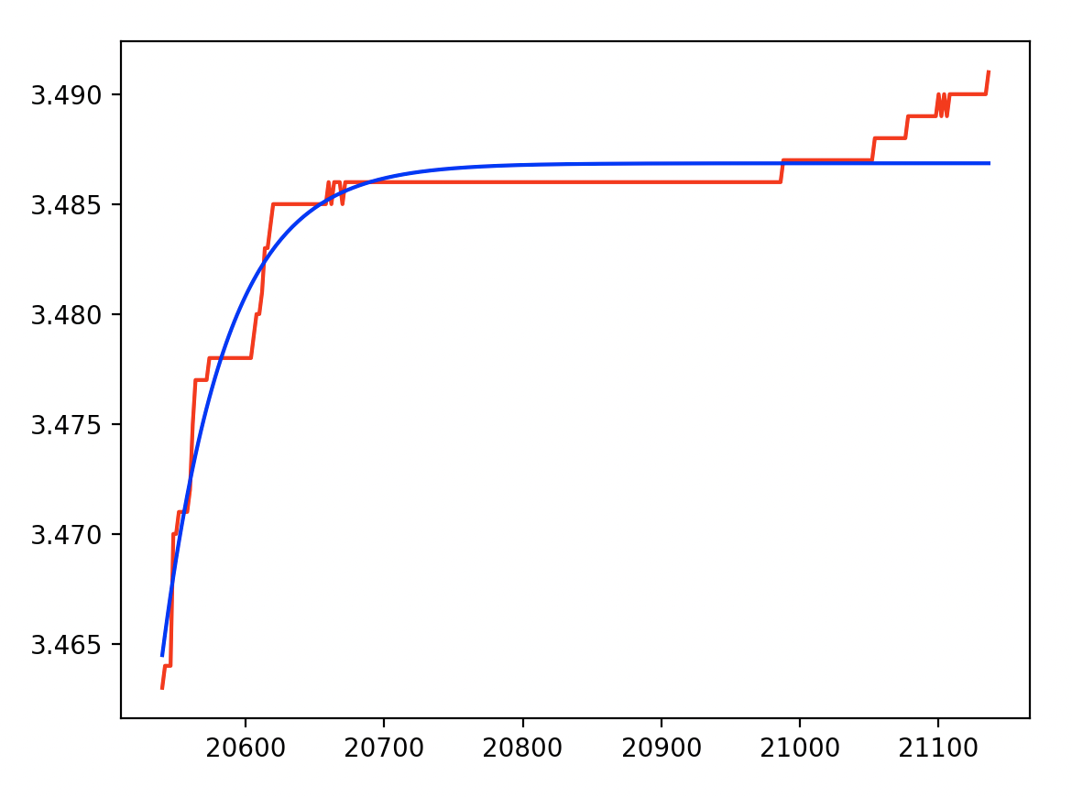
section 8
popt = [-0.0223724 3.48685707 0.02180562]
R0 = 0.0315
R1 = 0.0140
R1 * C1 = 45.8597
C1 = 3275.6959
voltage_est_MSE = 1.654324595551514e-06

Slide 13
part 2
@3.2V, 3.0V, 2.8V, 2.4V

Slide 14
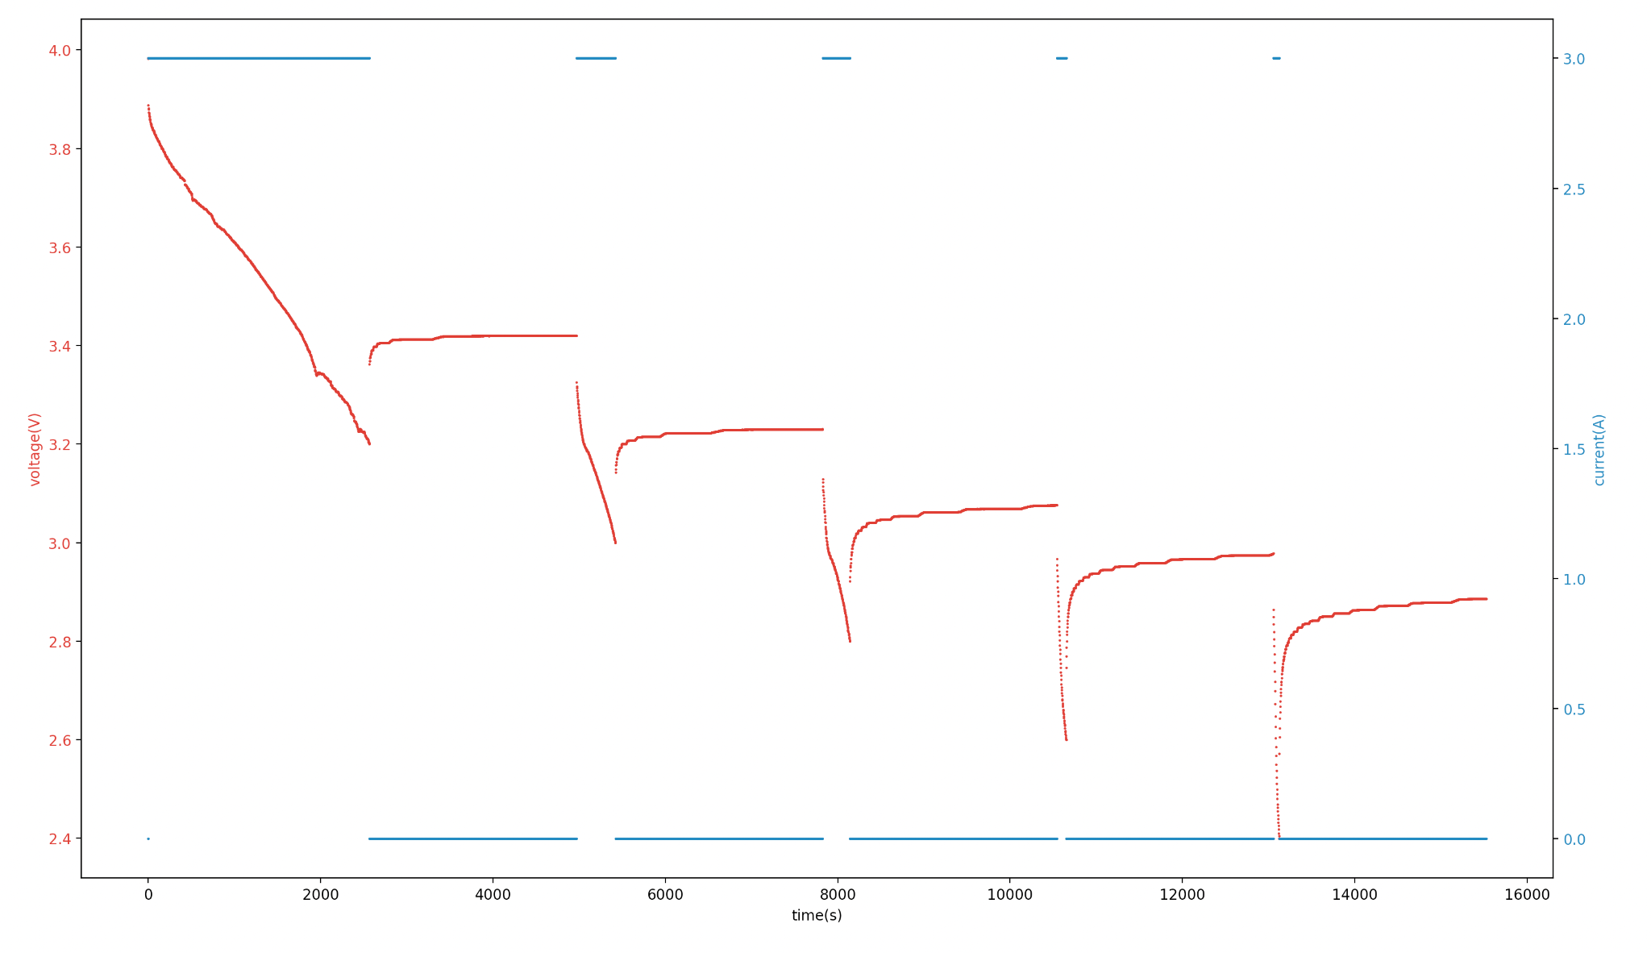
10-15/2021-10-15-17-42-11-EBC-A20-1-1-lower-voltage-equi-circuit.csv
split into 8 sections of “discharge-and-rest” (from left to right)

